Slide 1
PROJECT TITLE Secure data Hiding in images using steganography
CAPSTONE PROJECT
Presented By: YESWANTH KUMAR SENKHAVARAPU
College Name & Department : Audisankara College Of Engineering And Technology & ECE

Slide 2
OUTLINE
Problem Statement
Technology used
Wow factor
End users
Result
Conclusion
Git-hub Link
Future scope

Slide 3
Problem Statement
With the rise of cyber threats and data breaches, secure communication is a major concern. Traditional encryption methods may draw attention, making them susceptible to attacks. Steganography provides an alternative by hiding data within images, ensuring covert and secure transmission of sensitive information.

Slide 4
Technology used
Programming Language: Python Libraries: OpenCV, NumPy, PIL (Pillow) Method: Least Significant Bit (LSB) Steganography Image Format: PNG (for lossless encoding) Development Platform: Jupyter Notebook, VS Code, PyCharm Operating System: Windows, Linux, macOS

Slide 5
Wow factors
Invisible Data Hiding: The message is embedded within an image without noticeable changes. Enhanced Security: Difficult to detect without a key or specific extraction method. No Suspicion: Unlike encryption, which raises suspicion, steganography hides data discreetly. Lossless Encoding: PNG format ensures no data loss during hiding and retrieval.

Slide 6
End users
Cybersecurity Professionals – Secure data transmission. Journalists & Whistleblowers – Protect confidential sources. Military & Intelligence Agencies – Covert communication. Businesses & Individuals – Safeguard sensitive data.

Slide 7
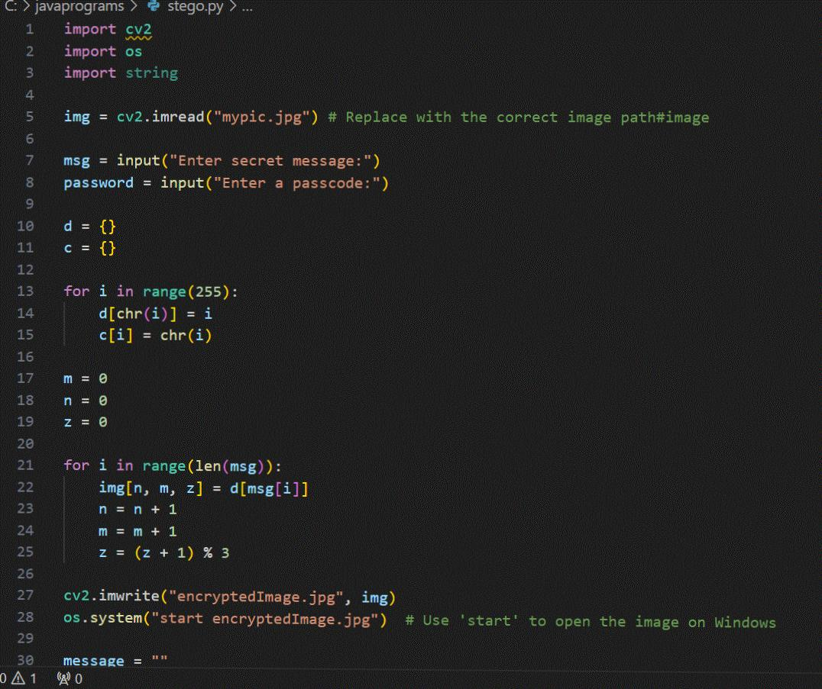
Results

Slide 8
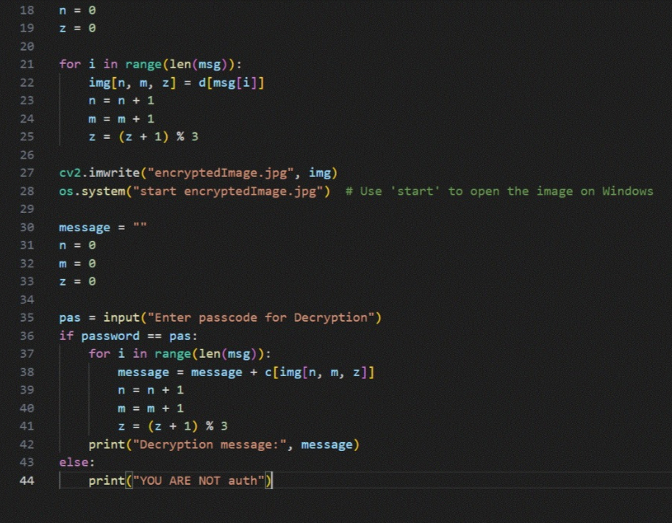
Results

Slide 9
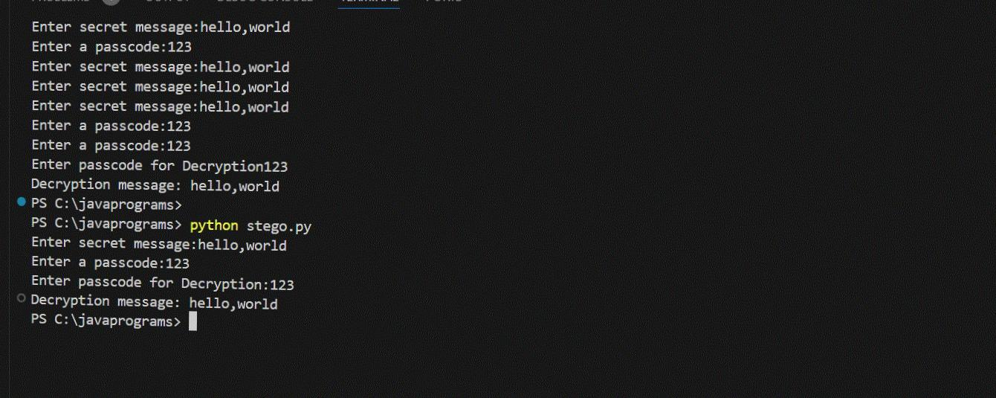
Results

Slide 10
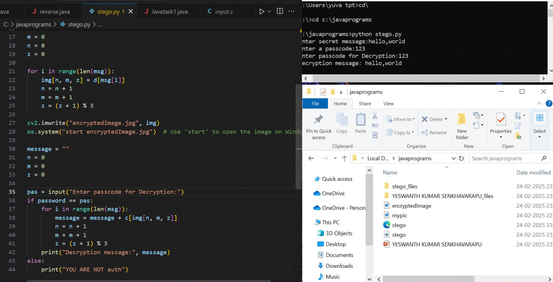
Results

Slide 11
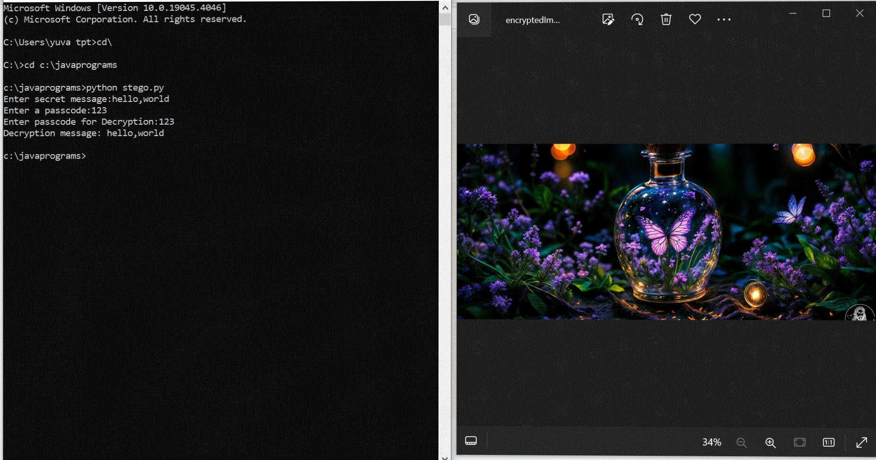
Results

Slide 12
Conclusion
Steganography offers a powerful method for secure data hiding. When combined with encryption, it can significantly enhance security for confidential communications. This project demonstrates how data can be secretly embedded and extracted using Python.

Slide 13
GitHub Link
Make sure that there should be readme file
https://github.com/yaswanth0329/Secure-Data-Hiding-In-Images-Using-Stegnography.git

Slide 14
Advanced Steganography Techniques: Implementing DCT-based or AI-powered steganography. Encryption Integration: Adding AES encryption for enhanced security. GUI Application: Developing a user-friendly interface for easy use. Video & Audio Steganography: Extending this concept beyond images.
Future scope(optional)

Slide 15
THANK YOU

